Slide 1


FakeNews Detection Using Deep Learning
Infosys Springboard 4.0 Internship Project (Artificial Intelligence)

Slide 2
About Dataset and Data Preprocessing
Contents
Problem Statement
Modeling Approach
Models Used and Hyperparameter Tuning
Modelling Results and Future Scope
Presentation Title

Slide 3
Use Case 1
Fake News Detection on Social Media Content Using Deep Learning
The rapid spread of information through social media platforms has made it increasingly difficult to discern credible news from misinformation. The proliferation of fake news has led to widespread public confusion, undermined trust in legitimate sources, and posed significant risks to public health and safety. To address this, artificial intelligence, particularly deep learning, offers a promising solution. Here we aim to develop a deep learning model to detect and filter out false information from digital platforms by analyzing textual content and this will help identify misleading information, and protect the public from the adverse effects of misinformation.

Slide 4




Continued…
Reputation Management
- Protecting Brand Reputation
- Crisis Management
Public Safety and Awareness
Emergency Response
Health Information
Advertising and Marketing
Targeted advertising
- Campaign effectiveness
Content Moderation
- Ensuring Platform Integrity
- Building User Trust

Slide 5

Use Case 2
Fake Job Posting Detection
In the digital age, job hunting has become increasingly reliant on online platforms. However, this convenience comes with a dark side: the proliferation of fake job postings. These deceptive listings aim to defraud unsuspecting job seekers, often with malicious intent. Recognizing and combating this growing problem is crucial for protecting job seekers and ensuring the integrity of the online job market.

Slide 6

The Problem of Fake Job Postings
1
Financial Scams
Fake job postings are often used to lure victims into financial scams. They may require victims to pay fees for training, background checks, or other bogus services.
2
Identity Theft
Fake job postings can also be used to steal personal information, such as social security numbers, bank account details, and other sensitive data.
3
Time and Effort Wasted
Victims of fake job postings waste valuable time and effort applying for jobs that don't exist. This can lead to frustration, anxiety, and a sense of hopelessness in the job search.
4
Reputational Damage
Fake job postings can damage the reputation of legitimate businesses and recruitment agencies, making it difficult for them to attract genuine job seekers.

Slide 7
Challenges in Identifying Fake Postings
Sophistication of Fake Postings
Lack of Transparency
Limited Data Availability
Many job posting websites lack transparency and verification processes, making it difficult to identify the legitimacy of the postings.
There is a limited amount of publicly available data on fake job postings, making it challenging to train machine learning models effectively.
Fake job postings are becoming increasingly sophisticated, mimicking legitimate postings with detailed descriptions and realistic company information. This makes it harder for job seekers to distinguish them from genuine opportunities.

Slide 8

Use Case 3
Boosting Financial Market Stability by Predicting Fake News
Financial markets are highly sensitive to news, with both true and false information potentially causing significant fluctuations. The proliferation of fake news can lead to irrational market behaviors, making it essential to develop robust mechanisms to predict and mitigate its impact. This is where deep learning and machine learning (ML) come into play, offering advanced tools for detecting fake news and, consequently, enhancing market stability.

Slide 9

The Impact of Fake News on
Financial Markets
1
Market Volatility
Misinformation can cause panic or undue optimism, leading to abrupt market movements.
2
Investor Confidence
Persistent fake news undermines investor trust in market information.
3
Economic Decisions
Companies and governments may make misguided decisions based on false information.

Slide 10
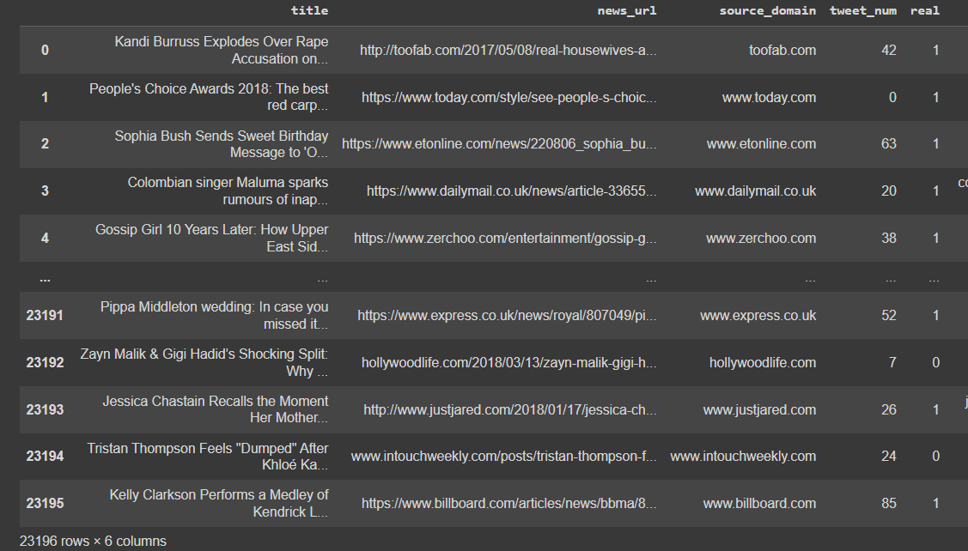
Overview of Dataset

Slide 11
Data Preprocessing
Data Preprocessing Steps:
Convert to Lower Case: Standardize text by converting all characters to lower case.
Contraction Splitting: Expand contractions (e.g., "don't" to "do not").
URL Removal: Remove hyperlinks from the text.
Remove New Lines: Eliminate newline characters (\n) from the text.
Remove Words Containing Numbers: Discard words that contain numerical characters.
Remove Extra Spaces: Trim unnecessary spaces from the text.
Remove Special Characters: Exclude punctuation and other special characters.
Stop Words Removal: Remove common stop words (e.g., "and", "the").
Lemmatization: Reduce words to their base or root form.

Slide 12
Modeling Approach
Project work flow
Feature Engineering
Training Models
Data Preprocessing
Result Analysis

Slide 13
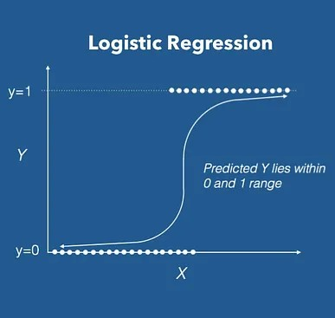
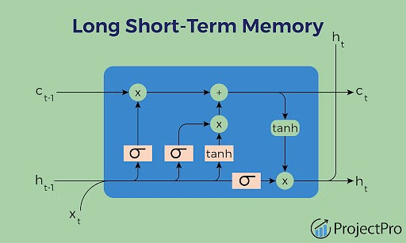
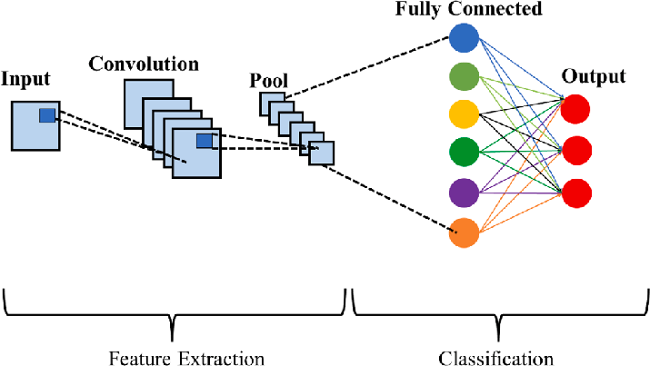
Models Build and Hyperparameter Tuning
Hyperparameter tuning helps us to find the best scoring model with suitable parameters.
Used GridSearchCV for the tuning.
Logistic Regression
CNN (Convolutional Neural Network)
LSTM (Long Short-Term Memory)

Slide 14
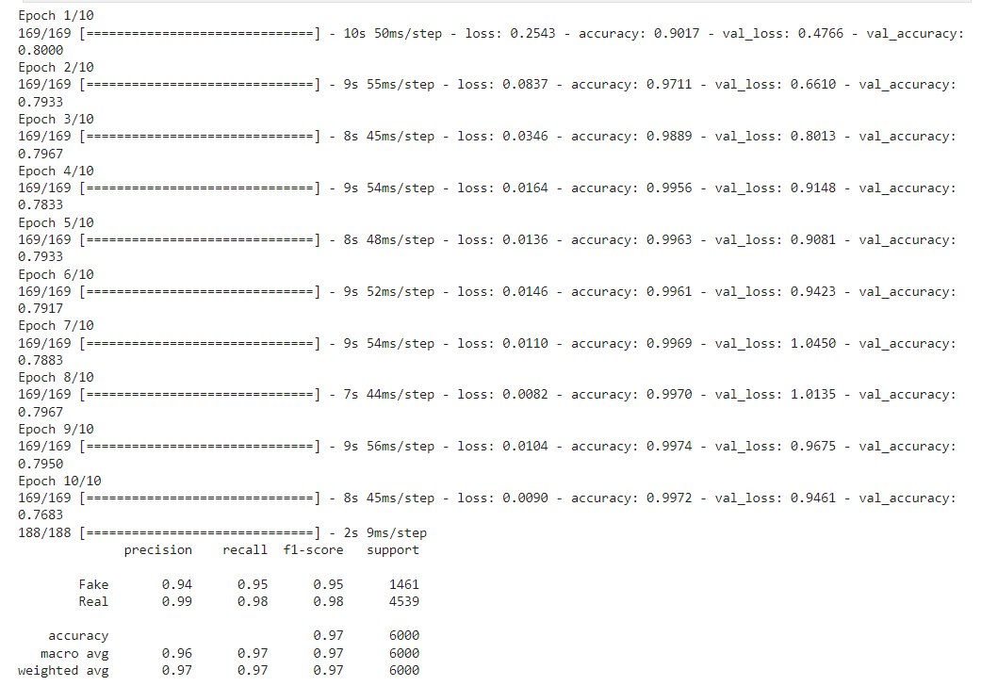
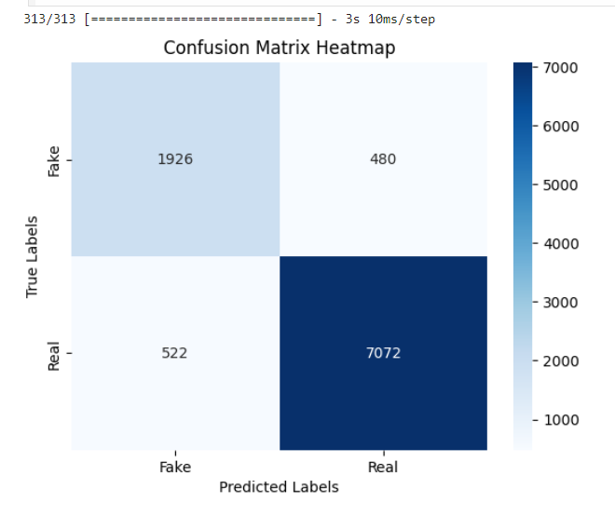
Model Results

Slide 15
Future Scope
Model Enhancements
Ensemble methods
Transfer learning
Ethical Considerations
Bias mitigation
Privacy and security
Regular Updates and Maintenance
Model retraining
Algorithm optimization
Scalability and Deployment
Scalable solutions
Cloud integration

Slide 16
Thank you
Thank you Infosys Springboard for the wonderful opportunity to show case our work!

